Slide 1

MTECH Project Review 1
Submitted by
CHANDRA MOULI NANDAMUDI
MTECH_IOT
AP23122100006
Under the Guidance of
Prof. Rupesh Kumar

Slide 2
OUTLINE
TITLE
PROBLEM STATEMENT
EXISTING WORK
METHODOLOGY
OUTPUT
CONCLUSION
CODE LINK
PROPOSED WORK
TIMELINE

Slide 3
Energy Efficient Placement of ML-Based Services in IOT Networks

Slide 4
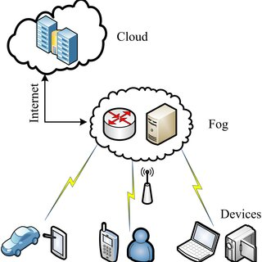
Problem Statement
Challenge: High energy consumption and latency due to centralized processing of IoT data in cloud data centers.
Objective: To optimize the placement of machine learning services in IoT-fog-cloud networks, reducing power consumption and improving performance.

Slide 5
Existing Work
Method: Implement a Mixed Integer Linear Programming (MILP) model for optimal placement of ML services (DNN layers) in a cloud-fog architecture. -
Key Focus: Embedding virtual machines (VMs) at IoT, fog, and cloud layers for efficient processing. - Result: Achieved up to 65% power savings through better allocation of VMs.
REFERENCE--Alenazi, Mohammed M., Barzan A. Yosuf, Sanaa H. Mohamed, Taisir EH El-Gorashi, and Jaafar MH Elmirghani. "Energy Efficient placement of ML-based services in IoT networks." In 2022 IEEE international mediterranean conference on communications and networking (MeditCom), pp. 19-24. IEEE, 2022.

Slide 6
Methodology
Network Architecture:
IoT Layer (data collection)
Access Fog Node (processing near the source)
Metro Fog Node (intermediate processing)
Cloud Data Center(central processing)
MILP Model:
Optimizes the placement of VMs representing different layers of DNNs across the network.
Balances network power consumption and processing power.

Slide 7
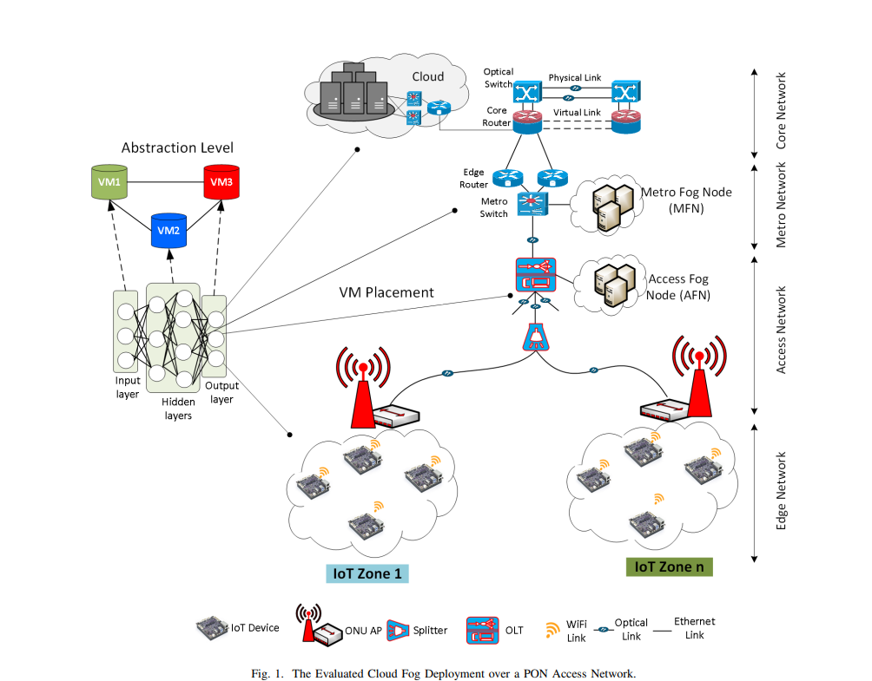
Cloud fog network architecture

Slide 8
Output
Single VM Allocation: Limited energy savings due to hardware constraints of IoT nodes.
Multiple VM Allocation: Substantial savings up to 65%, leveraging higher processing at the IoT layer.
Key Graphs:
Total power consumption (with different VM allocations)
Workload distribution across layers.

Slide 9
CODE LINK
https://colab.research.google.com/drive/1AkRJcY1WVMF6bmDail1ryrkKIPz4_ck2?authuser=1

Slide 10
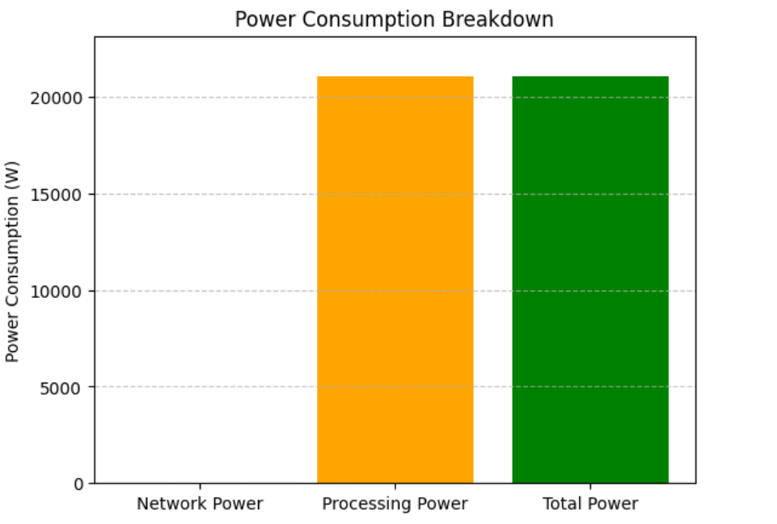
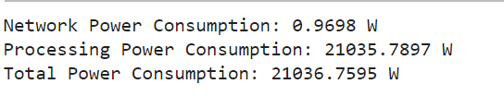

Slide 11
Conclusion
Success:
Multiple VM allocation at the IoT layer significantly reduces power consumption.
Impact:
Efficient VM placement improves resource utilization and reduces network transport energy.

Slide 12
Proposed Work
Title: Adaptive Heuristic and AI-Driven Optimization for Energy-Efficient Placement of ML Services in IoT Networks
Objective: To develop adaptive heuristic and AI-based algorithms for real-time optimization of Machine Learning (ML) service placement in IoT networks, with a focus on improving scalability, efficiency, and responsiveness compared to traditional Mixed Integer Linear Programming (MILP) methods.

Slide 13
TIMELINE
September 10 - October 10:Literature Review & Research Phase.
October 11 - October 25:Problem Definition & Requirement Gathering.
October 26 - November 10:System Design & Algorithm Selection
November 11 - November 30:Implementation Phase I (Core Algorithm Development).
December 1 - December 20:Implementation Phase II (System Integration):Integrate the heuristic and AI-driven optimization methods with IoT service management.
December 21 - January 5:Initial Testing & Debugging.

Slide 14
TIMELINE
January 6 - January 20:Optimization & Tuning:Fine-tune the optimization algorithms for better performance.
January 21 - February 10:Simulation & Experimentation:Set up simulation environments mimicking real-world IoT networks.
February 11 - March 5:Result Analysis & Fine-Tuning:Analyze energy consumption, latency, and other metrics.
March 6 - March 25:Final Implementation & Performance Validation:Finalize system implementation and optimize for all identified use cases.

Slide 15
TIMELINE
March 26 - April 10:Documentation & Report Writing:Prepare detailed project documentation.
April 11 - April 20:Final Review & Corrections:Review the entire project to ensure all objectives are met.Make any necessary final corrections.
April 21 - April 25:Project Submission & Presentation:

Slide 16
REFRENCES
Bonomi, F., Milito, R., Zhu, J., & Addepalli, S. (2012). "Fog Computing and Its Role in the Internet of Things." In Proceedings of the First Edition of the MCC Workshop on Mobile Cloud Computing, ACM, pp. 13-16.
2. Chiang, M., & Zhang, T. (2016). "Fog and IoT: An Overview of Research Opportunities." In IEEE Internet of Things Journal, vol. 3, no. 6, pp. 854-864.

